Slide 1



Match Minder
A Football Database Management System
Nishat Taaha
Roll: 1909002

Slide 2
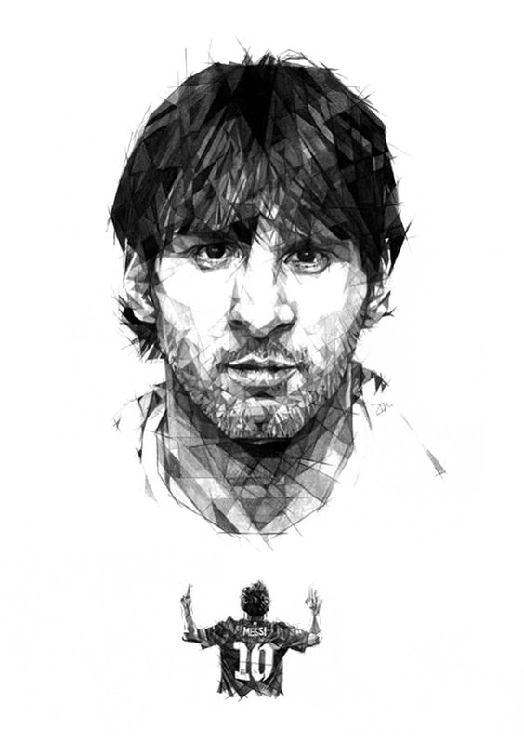

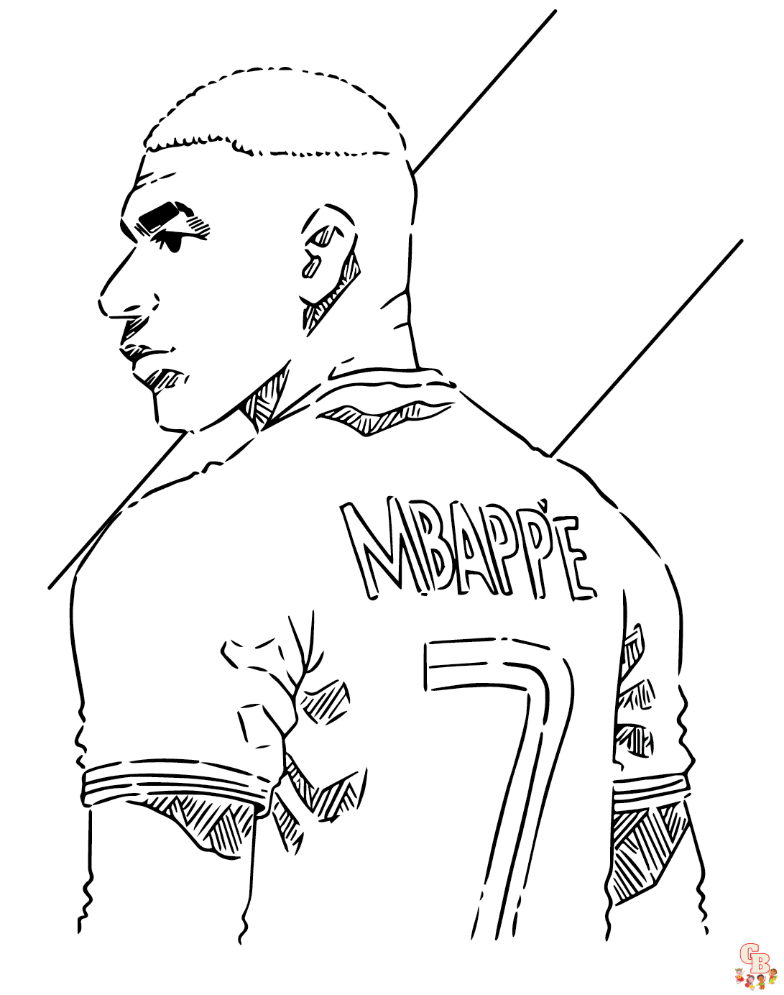
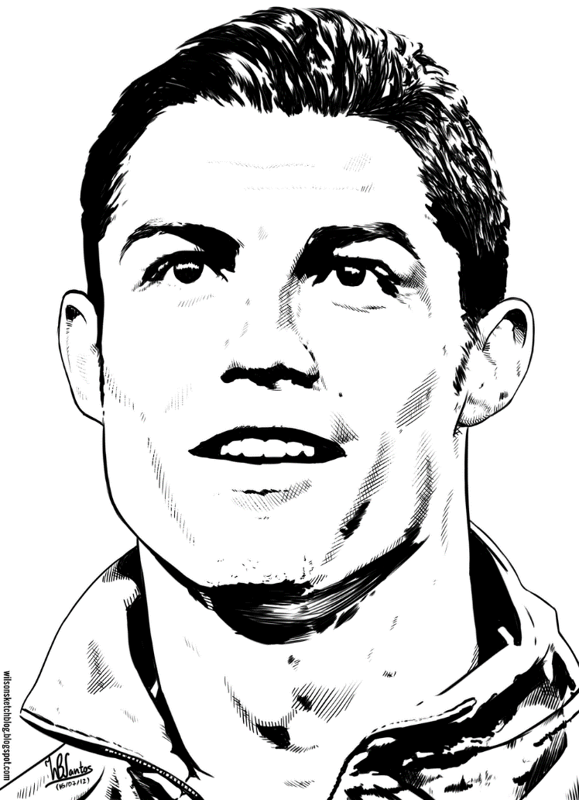


Slide 3
Tables Names
TEAMS
PLAYERS
STADIUMS
Tables
MATCHES
REFEREES
GOALS
COACHES
CARDS

Slide 4
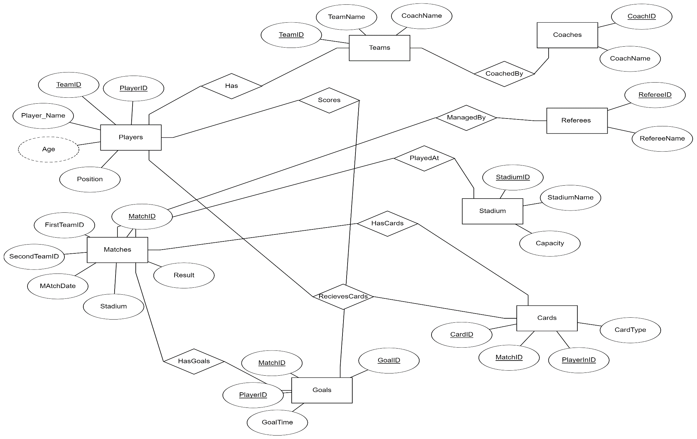
ER DIAGRAM

Slide 5



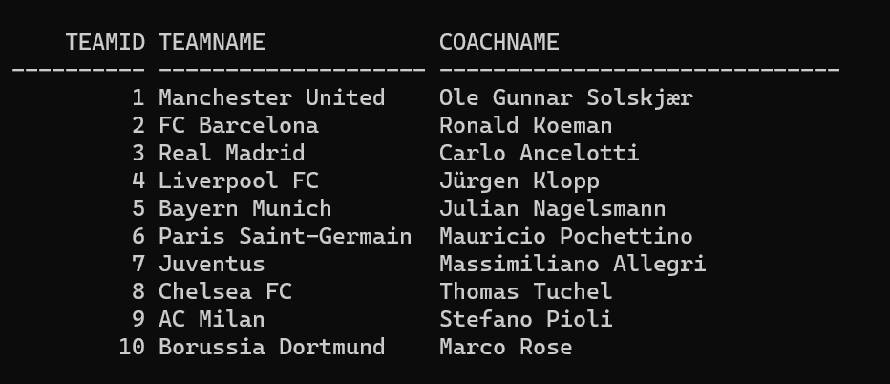
Table Contents
Note
Teams Table
CREATE TABLE Teams (
TeamID INT PRIMARY KEY,
TeamName VARCHAR(255) NOT NULL,
CoachName VARCHAR(255) NOT NULL
);

Slide 6
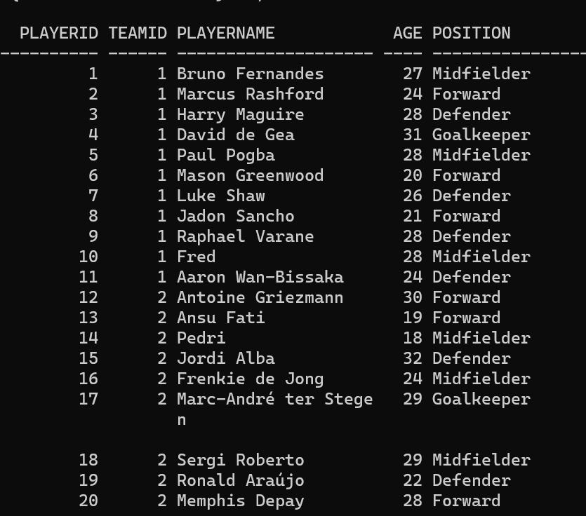
Table Contents
Note
Players Table
CREATE TABLE Players (
PlayerID INT PRIMARY KEY,
TeamID INT,
PlayerName VARCHAR(255) NOT NULL,
Age INT,
Position VARCHAR(50),
FOREIGN KEY (TeamID) REFERENCES Teams(TeamID)
);

Slide 7
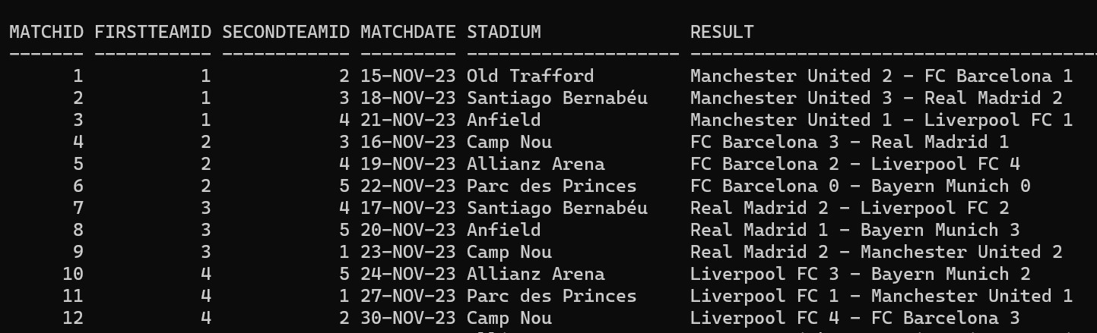
Table Contents
Note
Matches Table
CREATE TABLE Matches (
MatchID INT PRIMARY KEY,
firstTeamID INT,
secondTeamID INT,
MatchDate DATE,
Stadium VARCHAR(255),
Result VARCHAR(255),
FOREIGN KEY (firstTeamID) REFERENCES Teams(TeamID),
FOREIGN KEY (secondTeamID) REFERENCES Teams(TeamID)
);

Slide 8
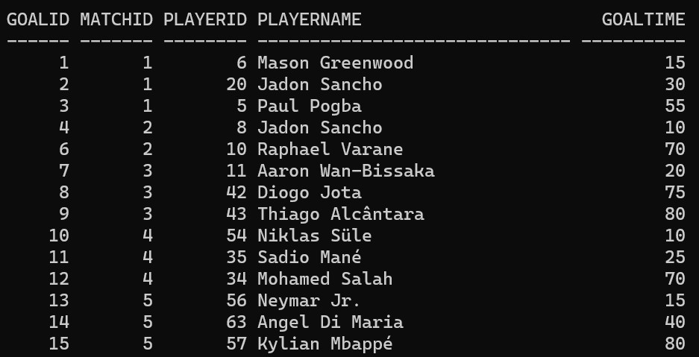
Table Contents
Note
Goals Table
CREATE TABLE Goals (
GoalID INT PRIMARY KEY,
MatchID INT,
PlayerID INT,
PlayerName VARCHAR(255),
GoalTime INT,
FOREIGN KEY (MatchID) REFERENCES Matches(MatchID),
FOREIGN KEY (PlayerID) REFERENCES Players(PlayerID)
);

Slide 9
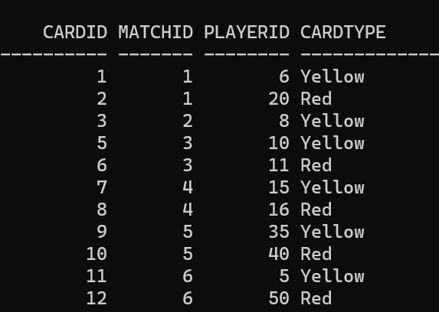
Table Contents
Note
Cards Table
CREATE TABLE Cards (
CardID INT PRIMARY KEY,
MatchID INT,
PlayerID INT,
CardType VARCHAR(50),
FOREIGN KEY (MatchID) REFERENCES Matches(MatchID),
FOREIGN KEY (PlayerID) REFERENCES Players(PlayerID)
);

Slide 10
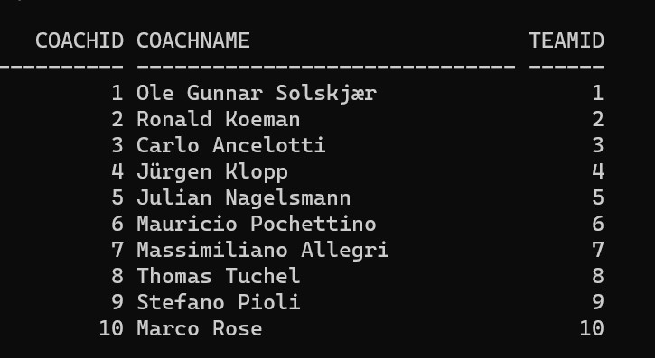
Table Contents
Note
Coaches Table
CREATE TABLE Coaches (
CoachID INT PRIMARY KEY,
CoachName VARCHAR(255) NOT NULL,
TeamID INT,
FOREIGN KEY (TeamID) REFERENCES Teams(TeamID)
);

Slide 11
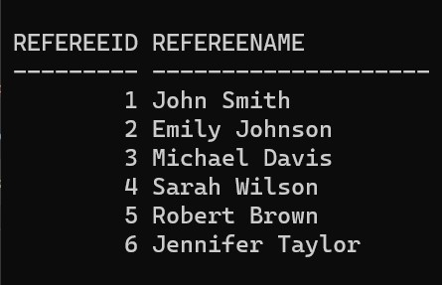
Table Contents
Note
Referees Table
CREATE TABLE Referees (
RefereeID INT PRIMARY KEY,
RefereeName VARCHAR(255) NOT NULL
);

Slide 12
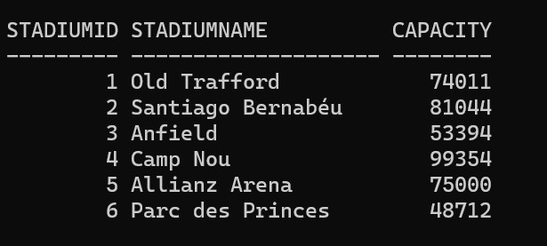
Table Contents
Note
Stadiums Table
CREATE TABLE Stadiums (
StadiumID INT PRIMARY KEY,
StadiumName VARCHAR(255) NOT NULL,
Capacity INT
);

Slide 13
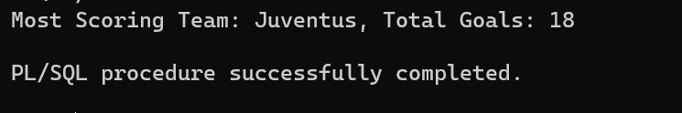
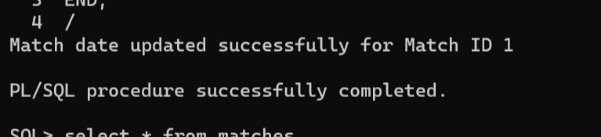
Let’s Identify The Team With Maximum Goal and Also Change A Random Match’s Date Using PL/SQL
BEGIN
find_most_scoring_team1;
END;
/
BEGIN
update_match_date(1, TO’25-
NOV-23', 'DD-MON-YY’));
END; /

Slide 14
Thank You >.<
Thank You >.<

